Slide 1

Recommender Systems:
Content-based Systems & Collaborative Filtering
Note to other teachers and users of these slides: We would be delighted if you found this our material useful in giving your own lectures. Feel free to use these slides verbatim, or to modify them to fit your own needs. If you make use of a significant portion of these slides in your own lecture, please include this message, or a link to our web site: http://www.mmds.org
Mining of Massive Datasets
Jure Leskovec, Anand Rajaraman, Jeff Ullman Stanford University
http://www.mmds.org

Slide 2
High Dimensional Data
High dim. data
Locality sensitive hashing
Clustering
Graph
data
PageRank, SimRank
Community Detection
Infinite
data
Filtering data streams
Web advertising
Dimensionality reduction
Spam Detection
Queries on streams
Machine learning
SVM
Decision Trees
Perceptron, kNN
Apps
Recommender systems
Association Rules
Duplicate document detection

Slide 3

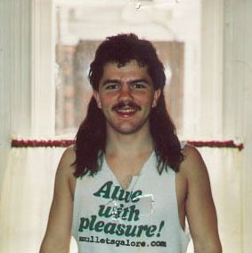
Example: Recommender Systems
Customer X
  Buys Metallica CD
  Buys Megadeth CD
Customer Y
  Does search on Metallica
  Recommender system suggests Megadeth from data collected about customer X

Slide 4










Recommendations
Examples:
Search
Recommendations
Items
Products, web sites,
blogs, news items, …

Slide 5
From Scarcity to Abundance
Shelf space is a scarce commodity for traditional retailers
  Also: TV networks, movie theaters,…
Web enables near-zero-cost dissemination
of information about products
  From scarcity to abundance
More choice necessitates better filters
  Recommendation engines
  How Into Thin Air made Touching the Void
  a bestseller: http://www.wired.com/wired/archive/12.10/tail.html
Notes:
In 1988, a British mountain climber named Joe Simpson wrote a book called Touching the Void, a harrowing account of near death in the Peruvian Andes. It got good reviews but, only a modest success, it was soon forgotten. Then, a decade later, a strange thing happened. Jon Krakauer wroteInto Thin Air, another book about a mountain-climbing tragedy, which became a publishing sensation. SuddenlyTouching the Void started to sell again.
Random House rushed out a new edition to keep up with demand. Booksellers began to promote it next to their Into Thin Air displays, and sales rose further. A revised paperback edition, which came out in January, spent 14 weeks on theNew York Times bestseller list. That same month, IFC Films released a docudrama of the story to critical acclaim. NowTouching the Void outsells Into Thin Air more than two to one.
What happened? In short, Amazon.com recommendations. The online bookseller's software noted patterns in buying behavior and suggested that readers who liked Into Thin Airwould also like Touching the Void. People took the suggestion, agreed wholeheartedly, wrote rhapsodic reviews. More sales, more algorithm-fueled recommendations, and the positive feedback loop kicked in.

Slide 6
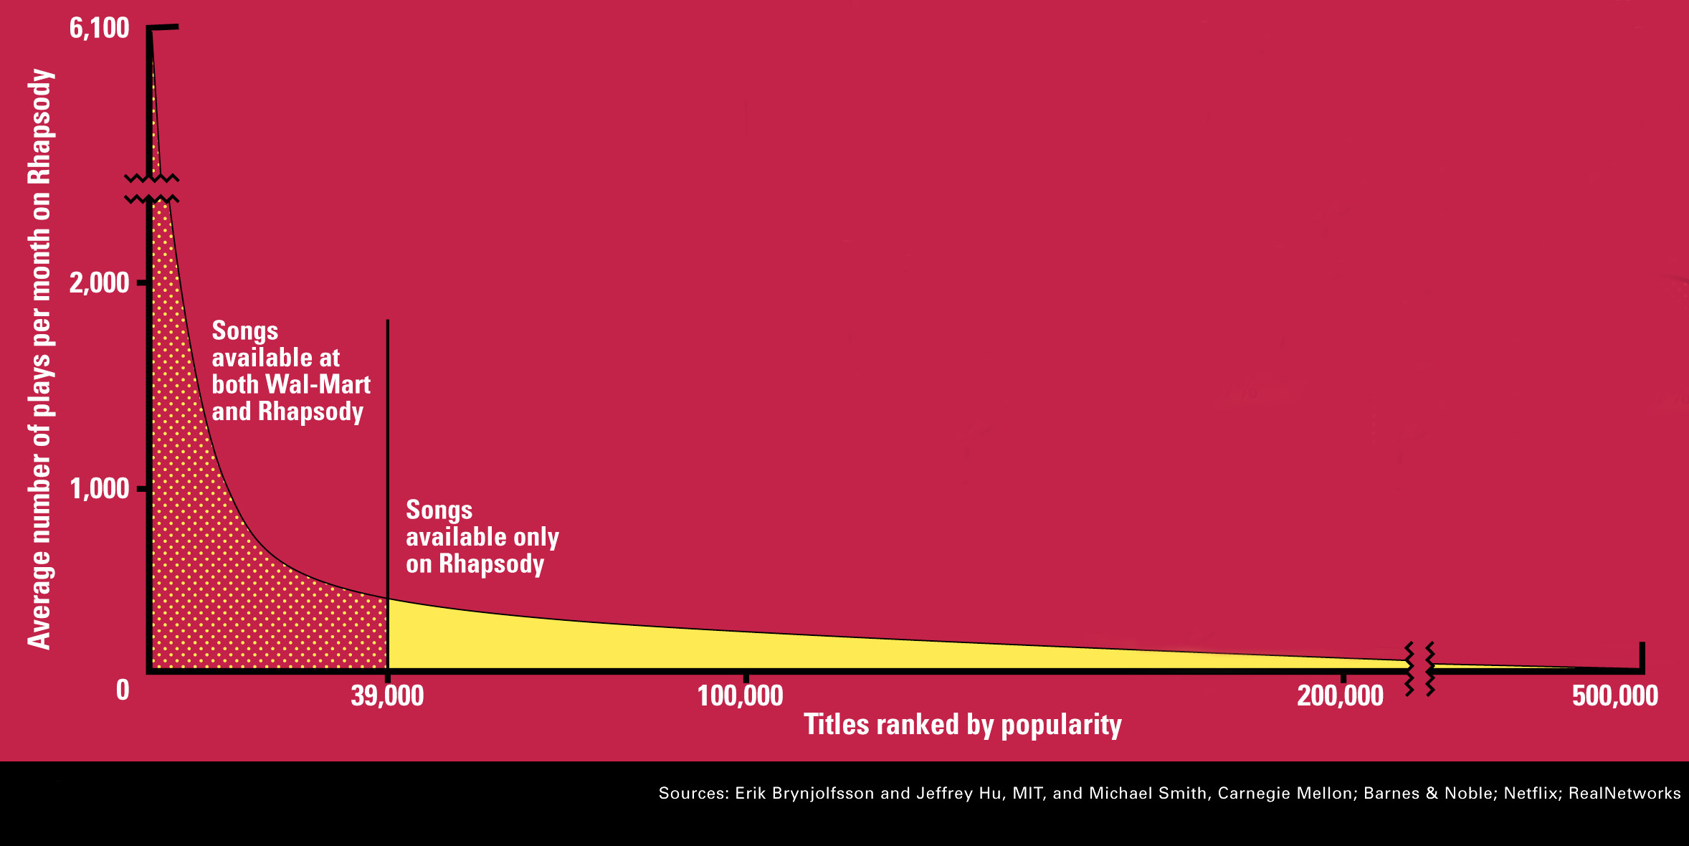
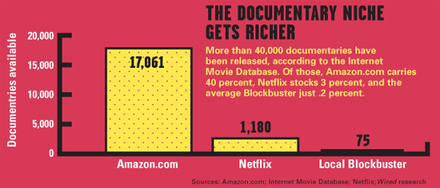
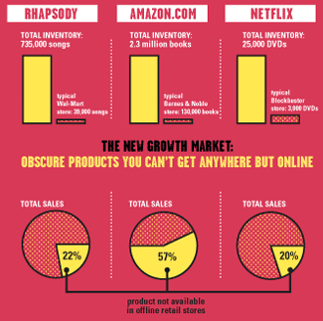
Sidenote: The Long Tail
Source: Chris Anderson (2004)

Slide 7
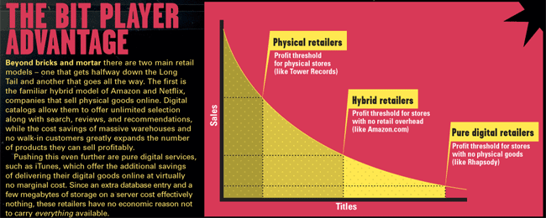
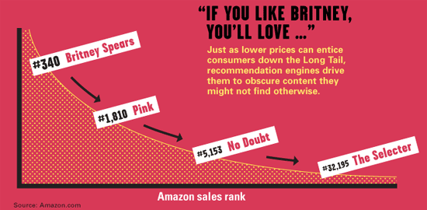
Physical vs. Online
    Read http://www.wired.com/wired/archive/12.10/tail.html to learn more!

Slide 8
Types of Recommendations
Editorial and hand curated
  List of favorites
  Lists of “essential” items
Simple aggregates
  Top 10, Most Popular, Recent Uploads
Tailored to individual users
  Amazon, Netflix, …

Slide 9
Formal Model
X = set of Customers
S = set of Items
Utility function u: X × S → R
  R = set of ratings
  R is a totally ordered set
  e.g., 0-5 stars, real number in [0,1]

Slide 10
Utility Matrix
Avatar
LOTR
Matrix
Pirates
Alice
Bob
Carol
David

Slide 11
Key Problems
(1) Gathering “known” ratings for matrix
  How to collect the data in the utility matrix
(2) Extrapolate unknown ratings from the
known ones
  Mainly interested in high unknown ratings
    We are not interested in knowing what you don’t like
    but what you like
(3) Evaluating extrapolation methods
  How to measure success/performance of
  recommendation methods

Slide 12
(1) Gathering Ratings
Explicit
  Ask people to rate items
  Doesn’t work well in practice – people
  can’t be bothered
Implicit
  Learn ratings from user actions
    E.g., purchase implies high rating
  What about low ratings?

Slide 13
(2) Extrapolating Utilities
Key problem: Utility matrix U is sparse
  Most people have not rated most items
  Cold start:
    New items have no ratings
    New users have no history
Three approaches to recommender systems:
  1) Content-based
  2) Collaborative
  3) Latent factor based
Today!

Slide 14
Content-based
Recommender Systems

Slide 15
Content-based Recommendations
Main idea: Recommend items to customer x similar to previous items rated highly by x
Example:
Movie recommendations
  Recommend movies with same actor(s),
  director, genre, …
Websites, blogs, news
  Recommend other sites with “similar” content

Slide 16
Plan of Action
Item profiles
likes
build
recommend
match
Red
Circles
Triangles
User profile

Slide 17
Item Profiles
For each item, create an item profile
Profile is a set (vector) of features
  Movies: author, title, actor, director,…
  Text: Set of “important” words in document
How to pick important features?
  Usual heuristic from text mining is TF-IDF
  (Term frequency * Inverse Doc Frequency)
    Term … Feature
    Document … Item

Slide 18
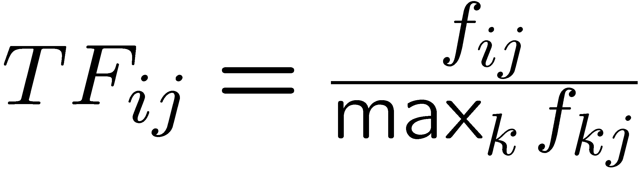
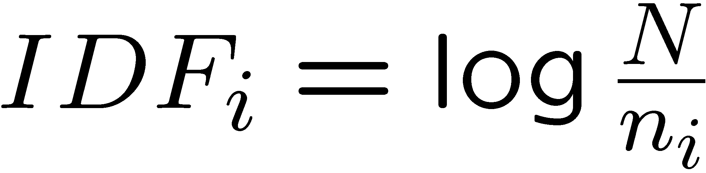
Sidenote: TF-IDF
f_{ij} = frequency of term (feature) i in doc (item) j
n_{i} = number of docs that mention term i
N = total number of docs
TF-IDF score: w_{ij} = TF_{ij} × IDF_{i}
Doc profile = set of words with highest TF-IDF scores, together with their scores
Note: we normalize TF
to discount for “longer”
documents

Slide 19
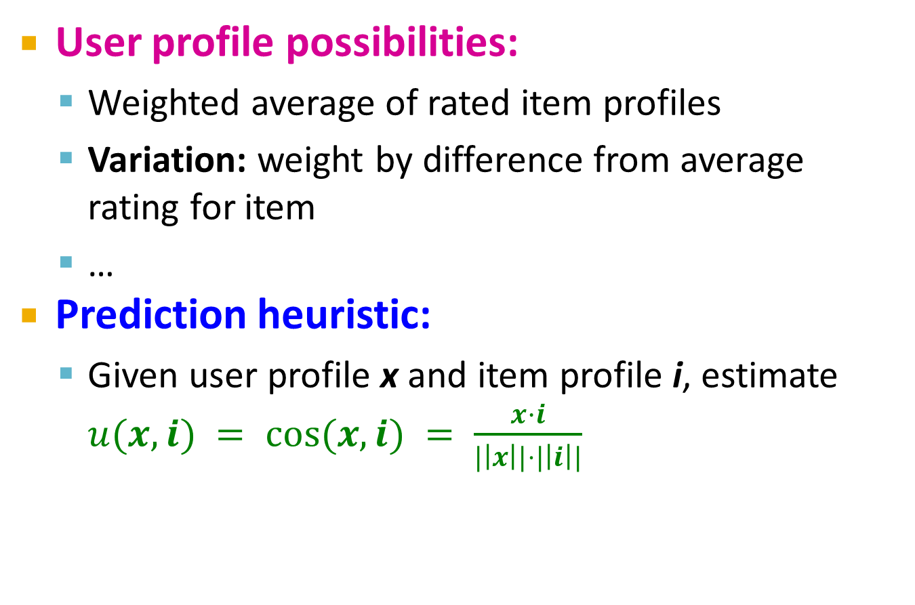
User Profiles and Prediction
User profile possibilities:
  Weighted average of rated item profiles
  Variation: weight by difference from average
  rating for item
  …
Prediction heuristic:
  Given user profile x and item profile i, estimate $u(x,i) = cos⁡(x,i) = \frac{x·i}{|\left|x\right||⋅|\left|i\right||}$

Slide 20
Pros: Content-based Approach
+: No need for data on other users
  No cold-start or sparsity problems
+: Able to recommend to users with
unique tastes
+: Able to recommend new & unpopular items
  No first-rater problem
+: Able to provide explanations
  Can provide explanations of recommended items by listing content-features that caused an item to be recommended

Slide 21
Cons: Content-based Approach
–: Finding the appropriate features is hard
  E.g., images, movies, music
–: Recommendations for new users
  How to build a user profile?
–: Overspecialization
  Never recommends items outside user’s
  content profile
  People might have multiple interests
  Unable to exploit quality judgments of other users

Slide 22
Collaborative Filtering
  Harnessing quality judgments of other users

Slide 23
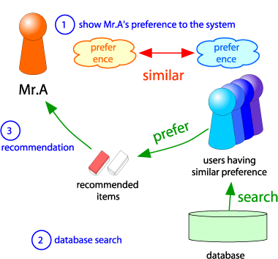
Collaborative Filtering
Consider user x
Find set N of other
users whose ratings
are “similar” to
x’s ratings
Estimate x’s ratings
based on ratings
of users in N
x
N

Slide 24
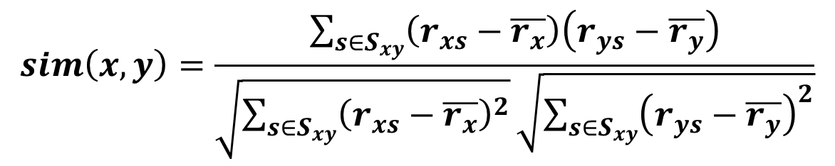
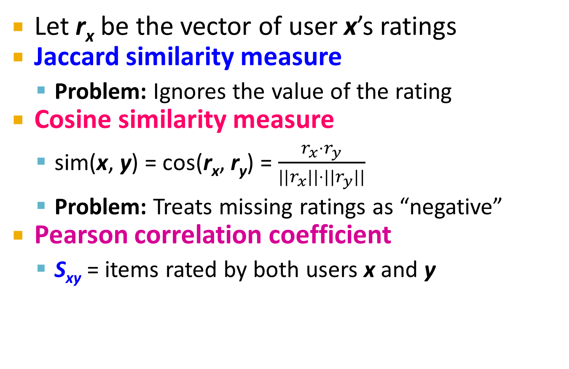
Finding “Similar” Users
r_{x} = [*, _, _, *, ***]
r_{y} = [*, _, **, **, _]
Let r_{x} be the vector of user x’s ratings
Jaccard similarity measure
  Problem: Ignores the value of the rating
Cosine similarity measure
  sim(x, y) = cos(r_{x}, r_{y}) = $\frac{r_{x}⋅r_{y}}{||r_{x}||⋅{||r}_{y}||}$
  Problem: Treats missing ratings as “negative”
Pearson correlation coefficient
  S_{xy} = items rated by both users x and y
r_{x}, r_{y} as sets:
r_{x} = {1, 4, 5}
r_{y} = {1, 3, 4}
r_{x}, r_{y} as points:
r_{x} = {1, 0, 0, 1, 3}
r_{y} = {1, 0, 2, 2, 0}
$$sim\left(x,y\right)=\frac{\sum_{s∈S_{xy}}{\left(r_{xs}−\overline{r_{x}}\right)\left(r_{ys}−\overline{r_{y}}\right)}}{\sqrt{\sum_{s∈S_{xy}}{{\left(r_{xs}−\overline{r_{x}}\right)}^{2}}}\sqrt{\sum_{s∈S_{xy}}{{\left(r_{ys}−\overline{r_{y}}\right)}^{2}}}}$$
r_{x}, r_{y} … avg.
rating of x, y
Notes:
-- Jaccard is not appropriate as we want to consider weights

Slide 25
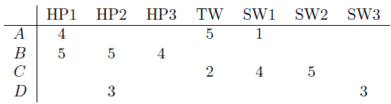
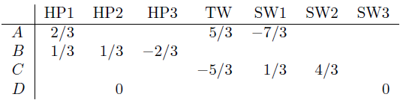

Similarity Metric
Cosine sim:
  $$sim(x, y) = \frac{\sum_{i}{r_{xi}⋅r_{yi}}}{\sqrt{\sum_{i}{r_{xi}^{2}}}⋅\sqrt{\sum_{i}{r_{yi}^{2}}}}$$
Intuitively we want: sim(A, B) > sim(A, C)
Jaccard similarity: 1/5 < 2/4
Cosine similarity: 0.386 > 0.322
  Considers missing ratings as “negative”
  Solution: subtract the (row) mean
sim A,B vs. A,C:
0.092 > -0.559
Notice cosine sim. is correlation when data is centered at 0

Slide 26
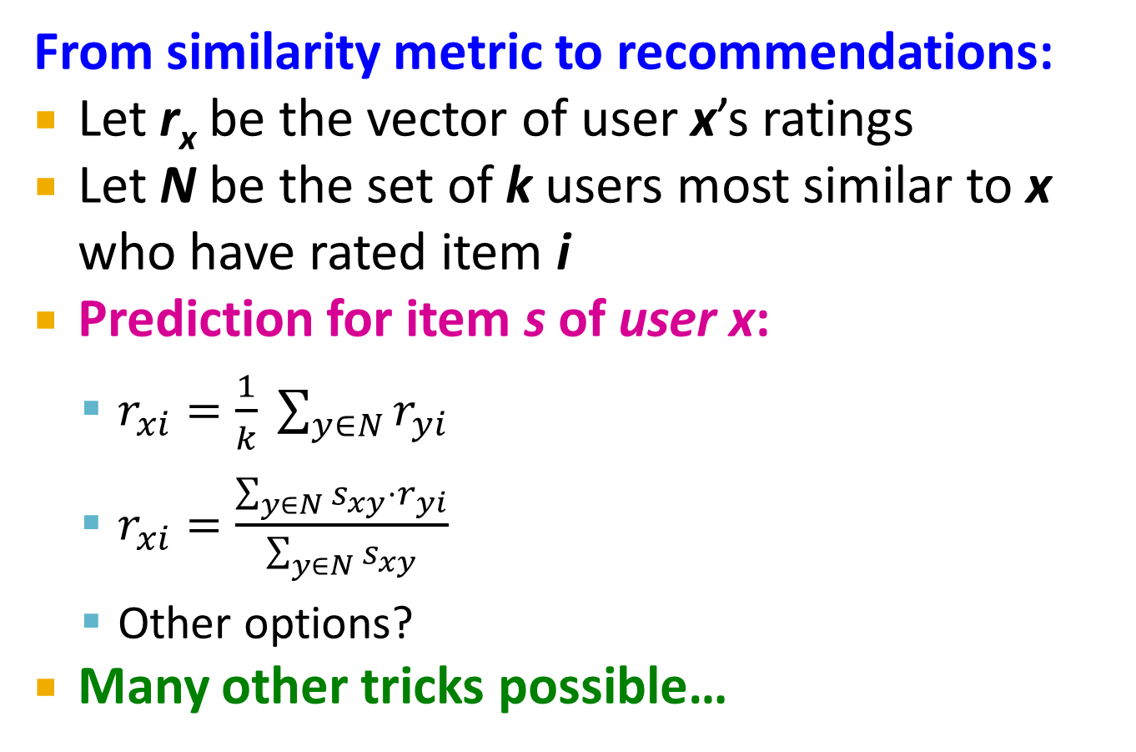
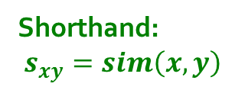
Rating Predictions
From similarity metric to recommendations:
Let r_{x} be the vector of user x’s ratings
Let N be the set of k users most similar to x who have rated item i
Prediction for item s of user x:
  $r_{xi}=\frac{1}{k} \sum_{y∈N}{r_{yi}}$
  $r_{xi}=\frac{\sum_{y∈N}{s_{xy}⋅r_{yi}}}{\sum_{y∈N}{s_{xy}}}$
  Other options?
Many other tricks possible…
Shorthand:
$s_{xy}=sim\left(x,y\right)$

Slide 27
Item-Item Collaborative Filtering
So far: User-user collaborative filtering
Another view: Item-item
  For item i, find other similar items
  Estimate rating for item i based
  on ratings for similar items
  Can use same similarity metrics and
  prediction functions as in user-user model
s_{ij}… similarity of items i and j
r_{xj}…rating of user u on item j
N(i;x)… set items rated by x similar to i

Slide 28
Item-Item CF (|N|=2)
users
12 | 11 | 10 | 9 | 8 | 7 | 6 | 5 | 4 | 3 | 2 | 1
 | 4 |  | 5 |  |  | 5 |  |  | 3 |  | 1 | 1
3 | 1 | 2 |  |  | 4 |  |  | 4 | 5 |  |  | 2
 | 5 | 3 | 4 |  | 3 |  | 2 | 1 |  | 4 | 2 | 3
 | 2 |  |  | 4 |  |  | 5 |  | 4 | 2 |  | 4
5 | 2 |  |  |  |  | 2 | 4 | 3 | 4 |  |  | 5
 | 4 |  |  | 2 |  |  | 3 |  | 3 |  | 1 | 6
movies
- unknown rating
- rating between 1 to 5

Slide 29
Item-Item CF (|N|=2)
users
12 | 11 | 10 | 9 | 8 | 7 | 6 | 5 | 4 | 3 | 2 | 1
 | 4 |  | 5 |  |  | 5 | ? |  | 3 |  | 1 | 1
3 | 1 | 2 |  |  | 4 |  |  | 4 | 5 |  |  | 2
 | 5 | 3 | 4 |  | 3 |  | 2 | 1 |  | 4 | 2 | 3
 | 2 |  |  | 4 |  |  | 5 |  | 4 | 2 |  | 4
5 | 2 |  |  |  |  | 2 | 4 | 3 | 4 |  |  | 5
 | 4 |  |  | 2 |  |  | 3 |  | 3 |  | 1 | 6
movies
- estimate rating of movie 1 by user 5

Slide 30
Item-Item CF (|N|=2)
users
12 | 11 | 10 | 9 | 8 | 7 | 6 | 5 | 4 | 3 | 2 | 1
 | 4 |  | 5 |  |  | 5 | ? |  | 3 |  | 1 | 1
3 | 1 | 2 |  |  | 4 |  |  | 4 | 5 |  |  | 2
 | 5 | 3 | 4 |  | 3 |  | 2 | 1 |  | 4 | 2 | 3
 | 2 |  |  | 4 |  |  | 5 |  | 4 | 2 |  | 4
5 | 2 |  |  |  |  | 2 | 4 | 3 | 4 |  |  | 5
 | 4 |  |  | 2 |  |  | 3 |  | 3 |  | 1 | 6
sim(1,m)
1.00
-0.18
0.41
-0.10
-0.31
0.59
movies
Neighbor selection:
Identify movies similar to
movie 1, rated by user 5
Here we use Pearson correlation as similarity:
1) Subtract mean rating m_{i} from each movie i
m₁ = (1+3+5+5+4)/5 = 3.6
row 1: [-2.6, 0, -0.6, 0, 0, 1.4, 0, 0, 1.4, 0, 0.4, 0]
2) Compute cosine similarities between rows

Slide 31
Item-Item CF (|N|=2)
users
12 | 11 | 10 | 9 | 8 | 7 | 6 | 5 | 4 | 3 | 2 | 1
 | 4 |  | 5 |  |  | 5 | ? |  | 3 |  | 1 | 1
3 | 1 | 2 |  |  | 4 |  |  | 4 | 5 |  |  | 2
 | 5 | 3 | 4 |  | 3 |  | 2 | 1 |  | 4 | 2 | 3
 | 2 |  |  | 4 |  |  | 5 |  | 4 | 2 |  | 4
5 | 2 |  |  |  |  | 2 | 4 | 3 | 4 |  |  | 5
 | 4 |  |  | 2 |  |  | 3 |  | 3 |  | 1 | 6
sim(1,m)
1.00
-0.18
0.41
-0.10
-0.31
0.59
movies
Compute similarity weights:
s_{1,3}=0.41, s_{1,6}=0.59

Slide 32
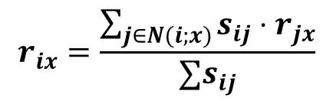
Item-Item CF (|N|=2)
users
12 | 11 | 10 | 9 | 8 | 7 | 6 | 5 | 4 | 3 | 2 | 1
 | 4 |  | 5 |  |  | 5 | 2.6 |  | 3 |  | 1 | 1
3 | 1 | 2 |  |  | 4 |  |  | 4 | 5 |  |  | 2
 | 5 | 3 | 4 |  | 3 |  | 2 | 1 |  | 4 | 2 | 3
 | 2 |  |  | 4 |  |  | 5 |  | 4 | 2 |  | 4
5 | 2 |  |  |  |  | 2 | 4 | 3 | 4 |  |  | 5
 | 4 |  |  | 2 |  |  | 3 |  | 3 |  | 1 | 6
movies
Predict by taking weighted average:
r_{1.5} = (0.41*2 + 0.59*3) / (0.41+0.59) = 2.6
$$r_{ix}=\frac{\sum_{j∈N(i;x)}{s_{ij}⋅r_{jx}}}{∑s_{ij}}$$

Slide 33

CF: Common Practice
Before:
Define similarity s_{ij} of items i and j
Select k nearest neighbors N(i; x)
  Items most similar to i, that were rated by x
Estimate rating r_{xi} as the weighted average:
baseline estimate for r_{xi}
μ = overall mean movie rating
b_{x} = rating deviation of user x
= (avg. rating of user x) – μ
b_{i} = rating deviation of movie i
$$b_{xi}=μ+b_{x}+b_{i}$$

Slide 34
Item-Item vs. User-User
Avatar
LOTR
Matrix
Pirates
Alice
Bob
Carol
David
In practice, it has been observed that item-item often works better than user-user
Why? Items are simpler, users have multiple tastes
Notes:
There is a difference in the typical behavior of users and items, as it
pertains to similarity. Intuitively, items tend to be classifiable in simple
terms. For example, music tends to belong to a single genre. It is impossi-
ble, e.g., for a piece of music to be both 60’s rock and 1700’s baroque. On
the other hand, there are individuals who like both 60’s rock and 1700’s
baroque, and who buy examples of both types of music.
The consequence is that it is easier to discover items that are similar because they belong
to the same genre, than it is to detect that two users are similar because
they prefer one genre in common, while each also likes some genres that
the other doesn’t care for.

Slide 35
Pros/Cons of Collaborative Filtering
+ Works for any kind of item
  No feature selection needed
- Cold Start:
  Need enough users in the system to find a match
- Sparsity:
  The user/ratings matrix is sparse
  Hard to find users that have rated the same items
- First rater:
  Cannot recommend an item that has not been
  previously rated
  New items, Esoteric items
- Popularity bias:
  Cannot recommend items to someone with
  unique taste
  Tends to recommend popular items

Slide 36
Hybrid Methods
Implement two or more different recommenders and combine predictions
  Perhaps using a linear model
Add content-based methods to
collaborative filtering
  Item profiles for new item problem
  Demographics to deal with new user problem

Slide 37
Remarks & Practical Tips
- Evaluation
- Error metrics
- Complexity / Speed

Slide 38
Evaluation
movies
1 | 3 | 4
 | 3 | 5 |  |  | 5
 |  | 4 | 5 |  | 5
 |  | 3
 |  | 3
2 |  |  | 2 |  | 2
 |  |  |  | 5
 | 2 | 1 |  |  | 1
 | 3 |  |  | 3
1
users

Slide 39
Evaluation
movies
1 | 3 | 4
 | 3 | 5 |  |  | 5
 |  | 4 | 5 |  | 5
 |  | 3
 |  | 3
2 |  |  | ? |  | ?
 |  |  |  | ?
 | 2 | 1 |  |  | ?
 | 3 |  |  | ?
1
users
Test Data Set

Slide 40
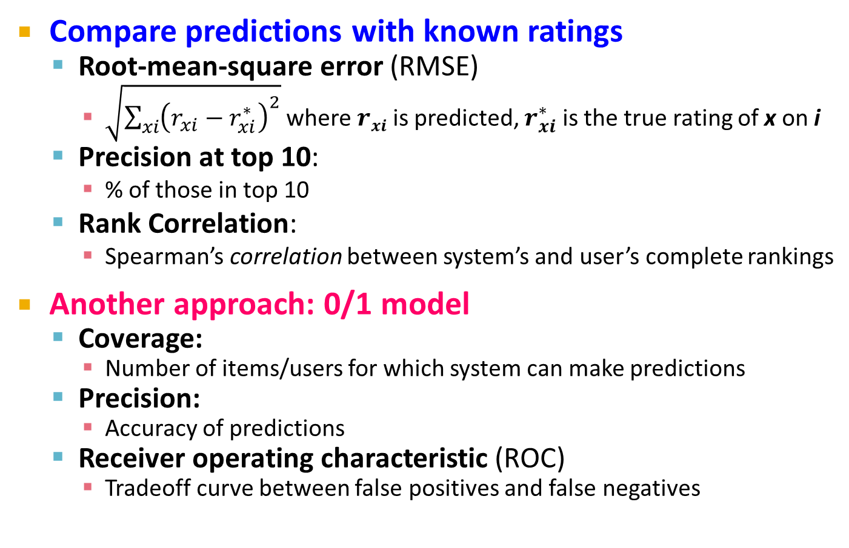
Evaluating Predictions
Compare predictions with known ratings
  Root-mean-square error (RMSE)
    $\sqrt{\sum_{xi}{{\left(r_{xi}−r_{xi}^{∗}\right)}^{2}}}$ where $rxi$ is predicted, $r_{xi}^{∗}$ is the true rating of x on i
  Precision at top 10:
    % of those in top 10
  Rank Correlation:
    Spearman’s correlation between system’s and user’s complete rankings
Another approach: 0/1 model
  Coverage:
    Number of items/users for which system can make predictions
  Precision:
    Accuracy of predictions
  Receiver operating characteristic (ROC)
    Tradeoff curve between false positives and false negatives

Slide 41
Problems with Error Measures
Narrow focus on accuracy sometimes
misses the point
  Prediction Diversity
  Prediction Context
  Order of predictions
In practice, we care only to predict high ratings:
  RMSE might penalize a method that does well
  for high ratings and badly for others

Slide 42
Collaborative Filtering: Complexity
Expensive step is finding k most similar customers: O(|X|)
Too expensive to do at runtime
  Could pre-compute
Naïve pre-computation takes time O(k ·|X|)
      X … set of customers
We already know how to do this!
  Near-neighbor search in high dimensions (LSH)
  Clustering
  Dimensionality reduction

Slide 43
Tip: Add Data
Leverage all the data
  Don’t try to reduce data size in an
  effort to make fancy algorithms work
  Simple methods on large data do best
Add more data
  e.g., add IMDB data on genres
More data beats better algorithms
http://anand.typepad.com/datawocky/2008/03/more-data-usual.html

