Slide 1

Analysis of Large Graphs:
Overlapping Communities
Note to other teachers and users of these slides: We would be delighted if you found this our material useful in giving your own lectures. Feel free to use these slides verbatim, or to modify them to fit your own needs. If you make use of a significant portion of these slides in your own lecture, please include this message, or a link to our web site: http://www.mmds.org
Mining of Massive Datasets
Jure Leskovec, Anand Rajaraman, Jeff Ullman Stanford University
http://www.mmds.org

Slide 2
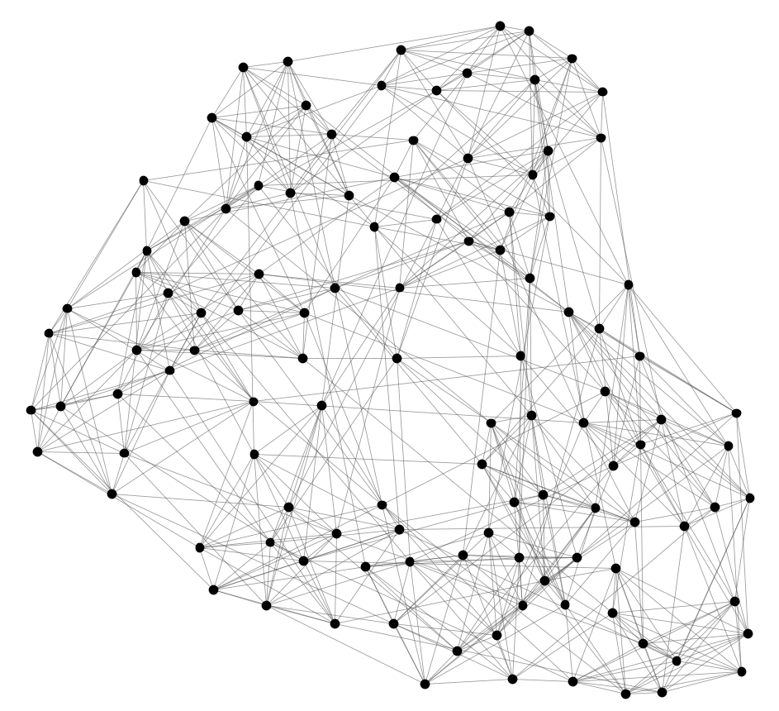
Identifying Communities
Can we identify node groups?
(communities, modules, clusters)
Nodes: Football Teams
Edges: Games played

Slide 3
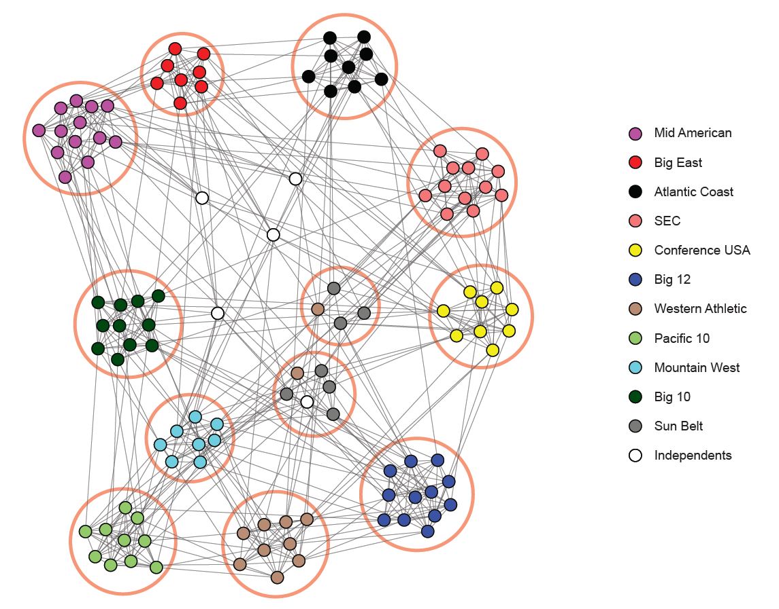
NCAA Football Network
NCAA conferences
Nodes: Football Teams
Edges: Games played

Slide 4
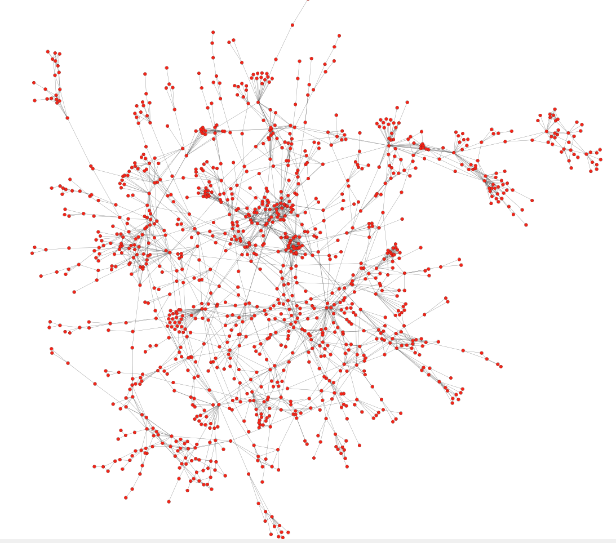
Protein-Protein Interactions
Can we identify functional modules?
Nodes: Proteins
Edges: Physical interactions

Slide 5
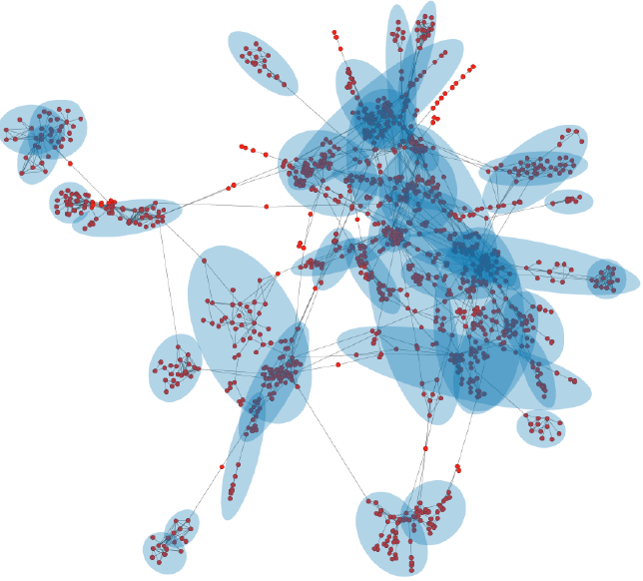
Protein-Protein Interactions
Functional modules
Nodes: Proteins
Edges: Physical interactions

Slide 6
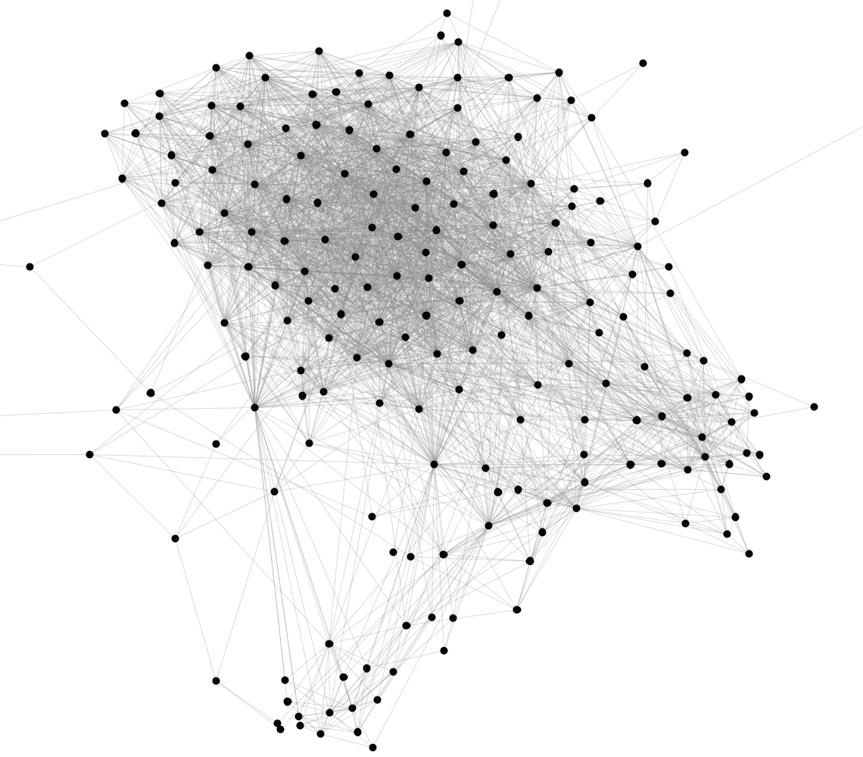
Facebook Network
Can we identify social communities?
Nodes: Facebook Users
Edges: Friendships

Slide 7
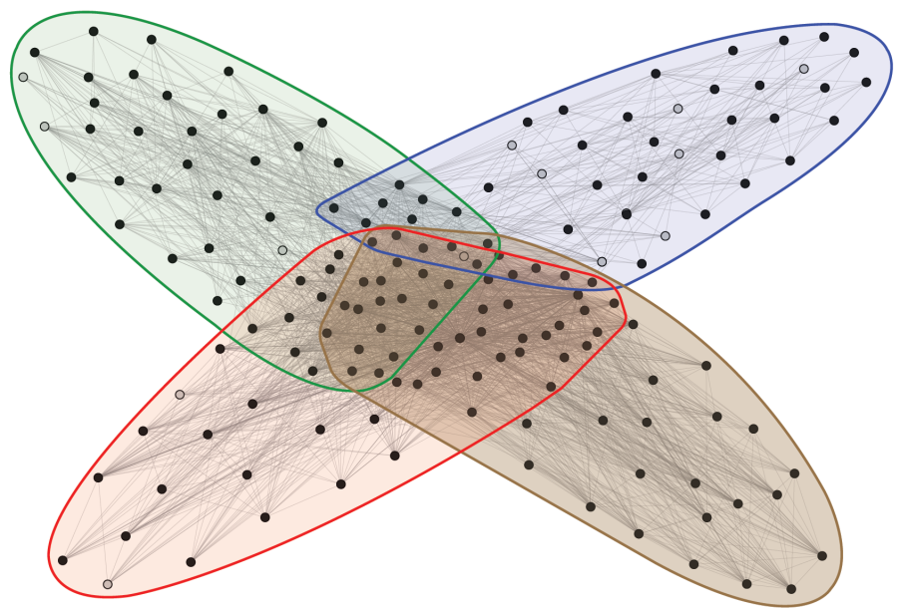
Facebook Network
Social communities
High school
Summer
internship
Stanford (Basketball)
Stanford (Squash)
Nodes: Facebook Users
Edges: Friendships

Slide 8
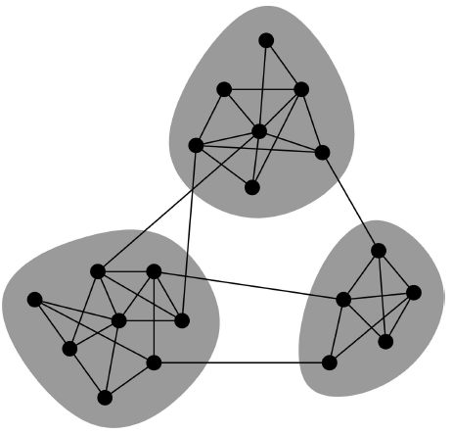
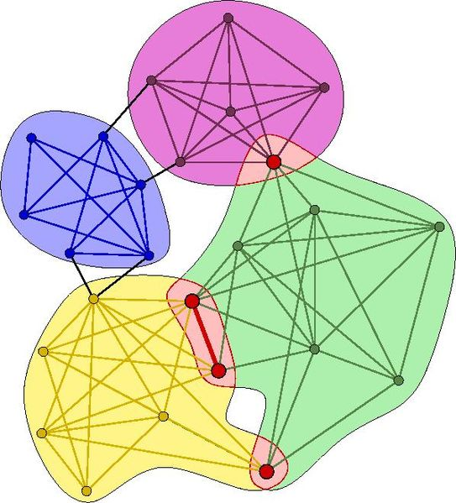
Overlapping Communities
Non-overlapping vs. overlapping communities

Slide 9
Non-overlapping Communities
Nodes
Nodes
Network
Adjacency matrix

Slide 10
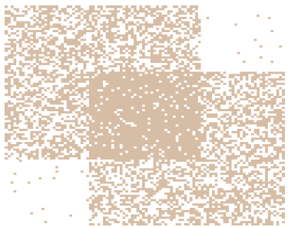
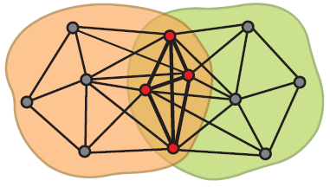
Communities as Tiles!
What is the structure of community overlaps:
Edge density in the overlaps is higher!
Communities as “tiles”

Slide 11

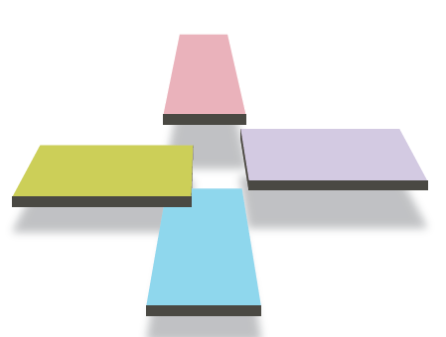
Recap so far…
Communities
in a network
This is what we want!

Slide 12
Plan of attack
1) Given a model, we generate the network:
2) Given a network, find the “best” model
Generative model for networks
B
A
F
D
E
C
G
H
B
Generative model for networks
A
F
D
E
C
G
H

Slide 13
Model of networks
Goal: Define a model that can generate networks
  The model will have a set of “parameters” that we will later want to estimate (and detect communities)
Q: Given a set of nodes, how do communities “generate” edges of the network?
Generative model for networks
B
A
F
D
E
C
G
H

Slide 14


Community-Affiliation Graph
Communities, C
p_{A}
p_{B}
Model
Memberships, M
Nodes, V
Model
Network
Generative model B(V, C, M, {p_{c}}) for graphs:
  Nodes V, Communities C, Memberships M
  Each community c has a single probability p_{c}
  Later we fit the model to networks to detect communities

Slide 15
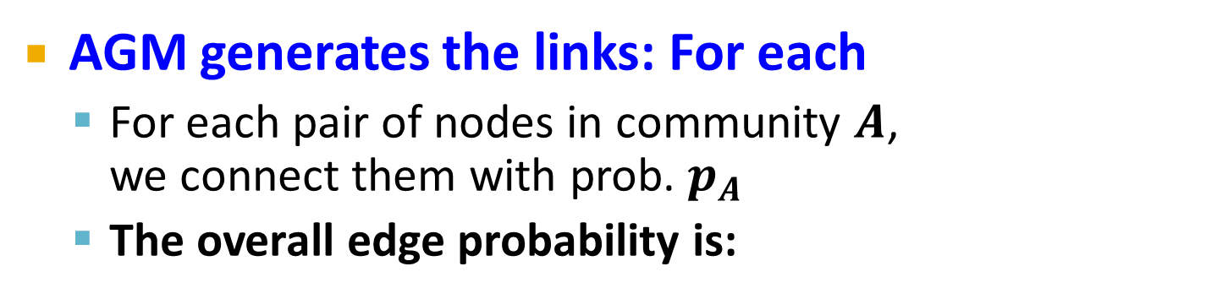


AGM: Generative Process
Communities, C
p_{A}
p_{B}
Model
Memberships, M
Nodes, V
Community Affiliations
Network
AGM generates the links: For each
  For each pair of nodes in community $A$,
  we connect them with prob. $p_{A}$
  The overall edge probability is:
$M_{u}$ … set of communities
node $u$ belongs to
If $u,v$ share no communities: $P\left(u,v\right)=ε$
  Think of this as an “OR” function: If at least 1 community says “YES” we create an edge

Slide 16
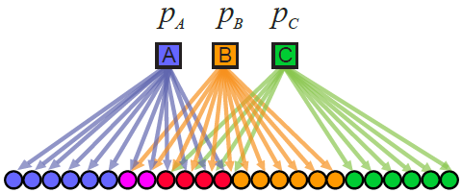
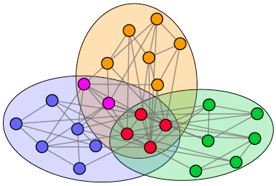
Recap: AGM networks
Model
Network

Slide 17
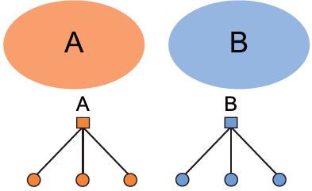
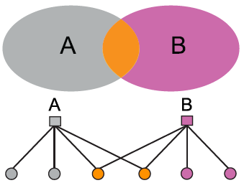
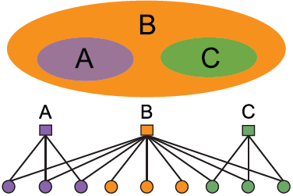
AGM: Flexibility
AGM can express a variety of community structures:
Non-overlapping, Overlapping, Nested

Slide 18
How do we detect communities with AGM?

Slide 19
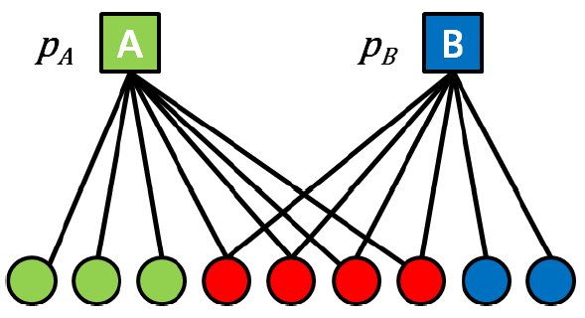

Detecting Communities
Detecting communities with AGM:
B
A
F
D
E
C
G
H
Given a Graph $G(V,E)$, find the Model
Affiliation graph M
Number of communities C
Parameters p_{c}

Slide 20
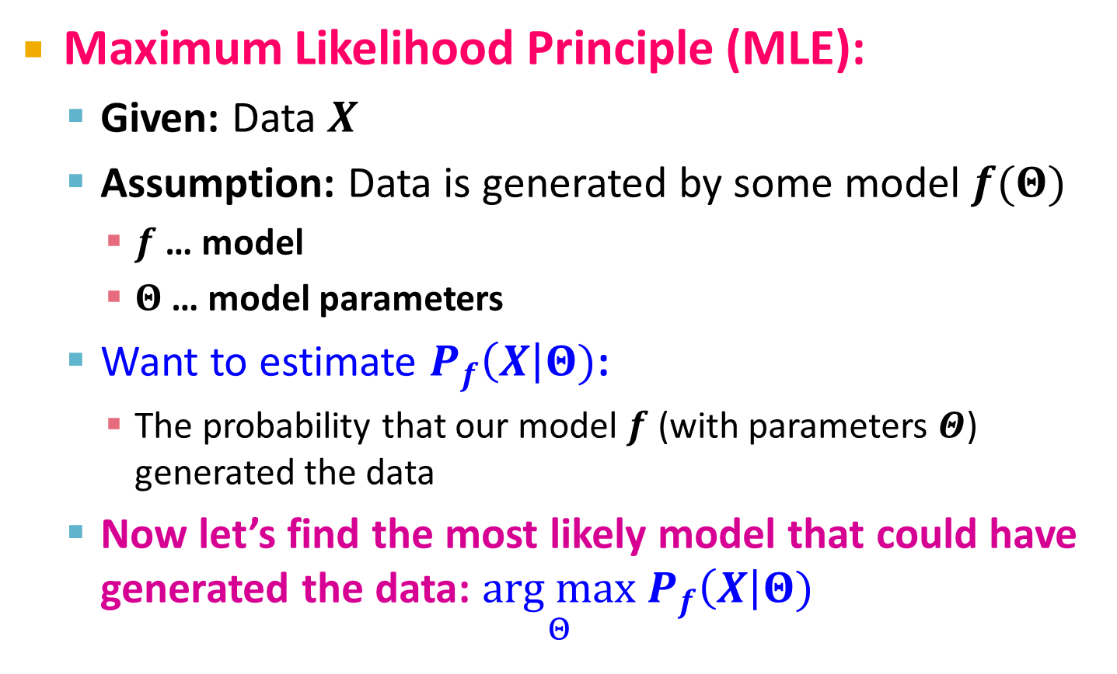
Maximum Likelihood Estimation
Maximum Likelihood Principle (MLE):
  Given: Data $X$
  Assumption: Data is generated by some model $f(Θ)$
    $f$ … model
    $Θ$ … model parameters
  Want to estimate $P_{f}\left(X\right|Θ)$:
    The probability that our model $f$ (with parameters $Θ$) generated the data
  Now let’s find the most likely model that could have generated the data: $\underset{Θ}{arg max}{ P}_{f}\left(X\right|Θ)$

Slide 21
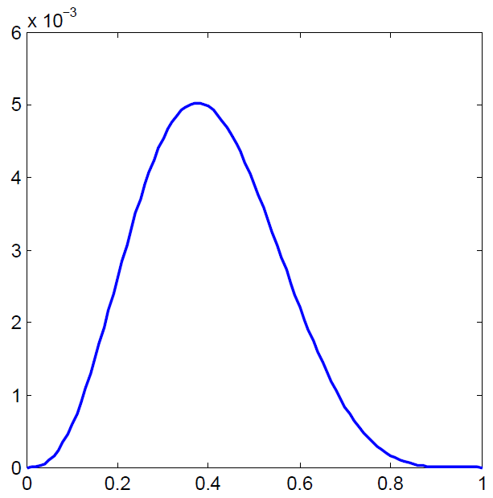
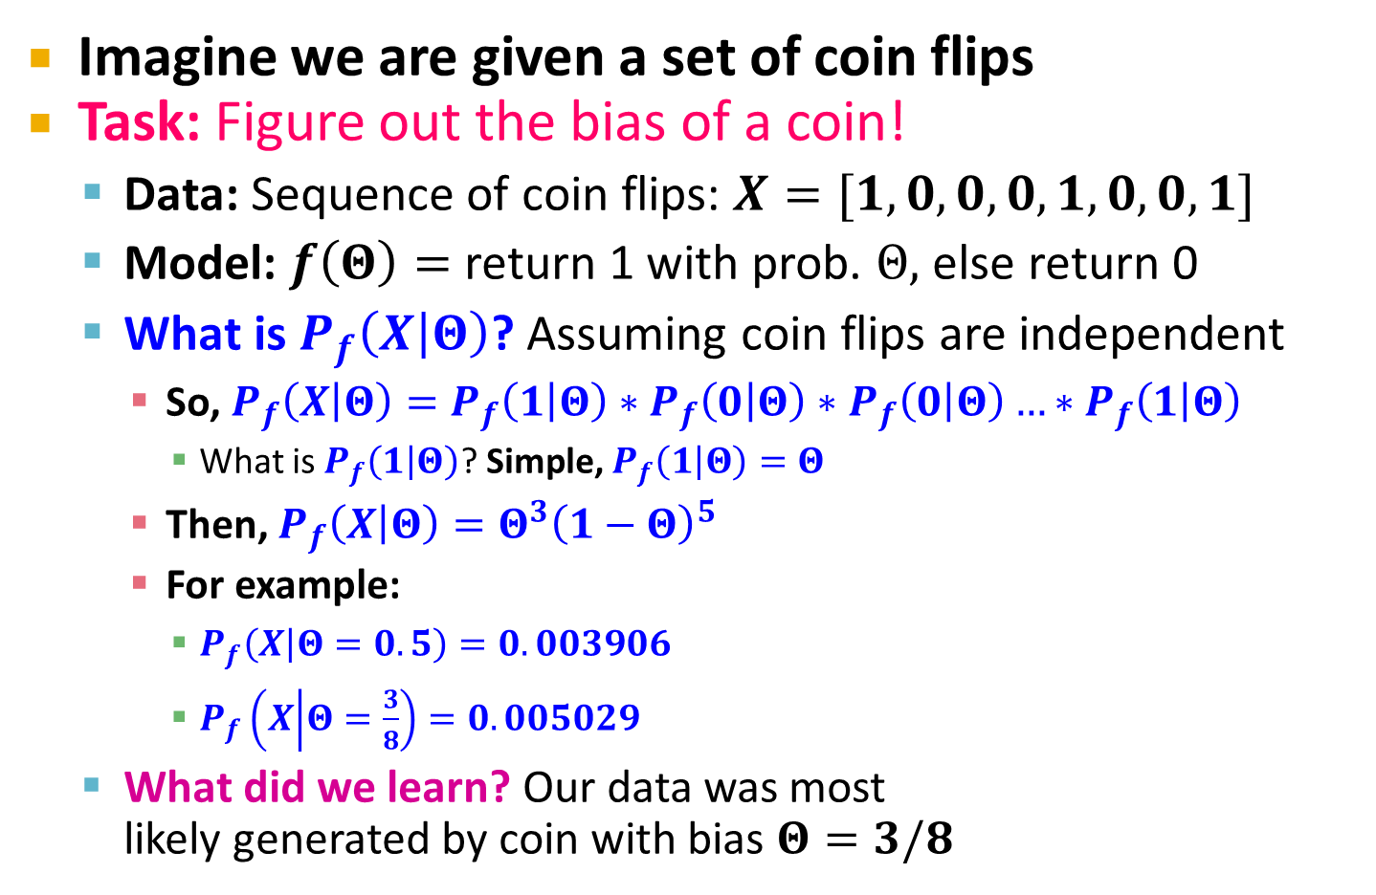



Example: MLE
Imagine we are given a set of coin flips
Task: Figure out the bias of a coin!
  Data: Sequence of coin flips: $X=[1, 0, 0, 0, 1,0,0,1]$
  Model: $f\left(Θ\right)=$ return 1 with prob. $Θ,$ else return 0
  What is $P_{f}\left(X | Θ\right)$? Assuming coin flips are independent
    So, $P_{f}\left(X | Θ\right)=P_{f}\left(1 | Θ\right)∗P_{f}\left(0 | Θ\right)∗P_{f}\left(0 | Θ\right)…∗P_{f}\left(1 | Θ\right)$
      What is $P_{f}\left(1 | Θ\right)$? Simple, $P_{f}\left(1 | Θ\right)=Θ$
    Then, $P_{f}\left(X | Θ\right)=Θ^{3}{\left(1−Θ\right)}^{5}$
    For example:
      $P_{f}\left(X | Θ=0.5\right)=0.003906$
      $P_{f}\left(X | Θ=\frac{3}{8}\right)=0.005029$
  What did we learn? Our data was most
  likely generated by coin with bias $Θ=3/8$
$$Θ^{∗}=3/8$$
$$P_{f}\left(X | Θ\right)$$
$$Θ$$

Slide 22



MLE for Graphs
How do we do MLE for graphs?
  Model generates a probabilistic adjacency matrix
  We then flip all the entries of the probabilistic matrix to obtain the binary adjacency matrix $A$
The likelihood of AGM generating graph G:
Flip biased coins
$$A$$
For every pair of nodes $u,v$ AGM gives the prob. $p_{uv}$ of them being linked
0 | 0.10 | 0.10 | 0.04
0.10 | 0 | 0.02 | 0.06
0.10 | 0.02 | 0 | 0.06
0.04 | 0.06 | 0.06 | 0
0 | 1 | 0 | 0
1 | 0 | 1 | 1
0 | 1 | 0 | 1
0 | 1 | 1 | 0

Slide 23
Graphs: Likelihood P(G|Θ)
Given graph G(V,E) and Θ, we calculate likelihood that Θ generated G: P(G|Θ)
G
0 | 0.9 | 0.9 | 0
0.9 | 0 | 0.9 | 0
0.9 | 0.9 | 0 | 0.9
0 | 0 | 0.9 | 0
0 | 1 | 1 | 0
1 | 0 | 1 | 0
1 | 1 | 0 | 1
0 | 0 | 1 | 0
A
B
Θ=B(V, C, M, {p_{c}})
G
P(G|Θ)

Slide 24
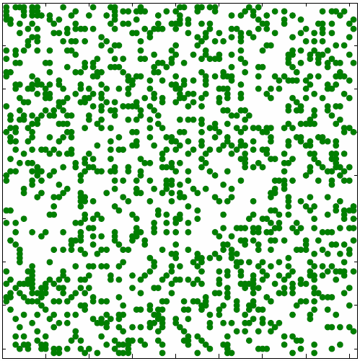
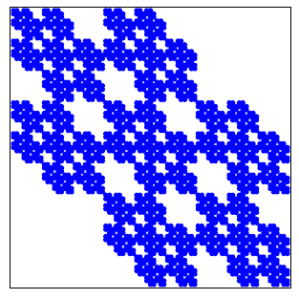

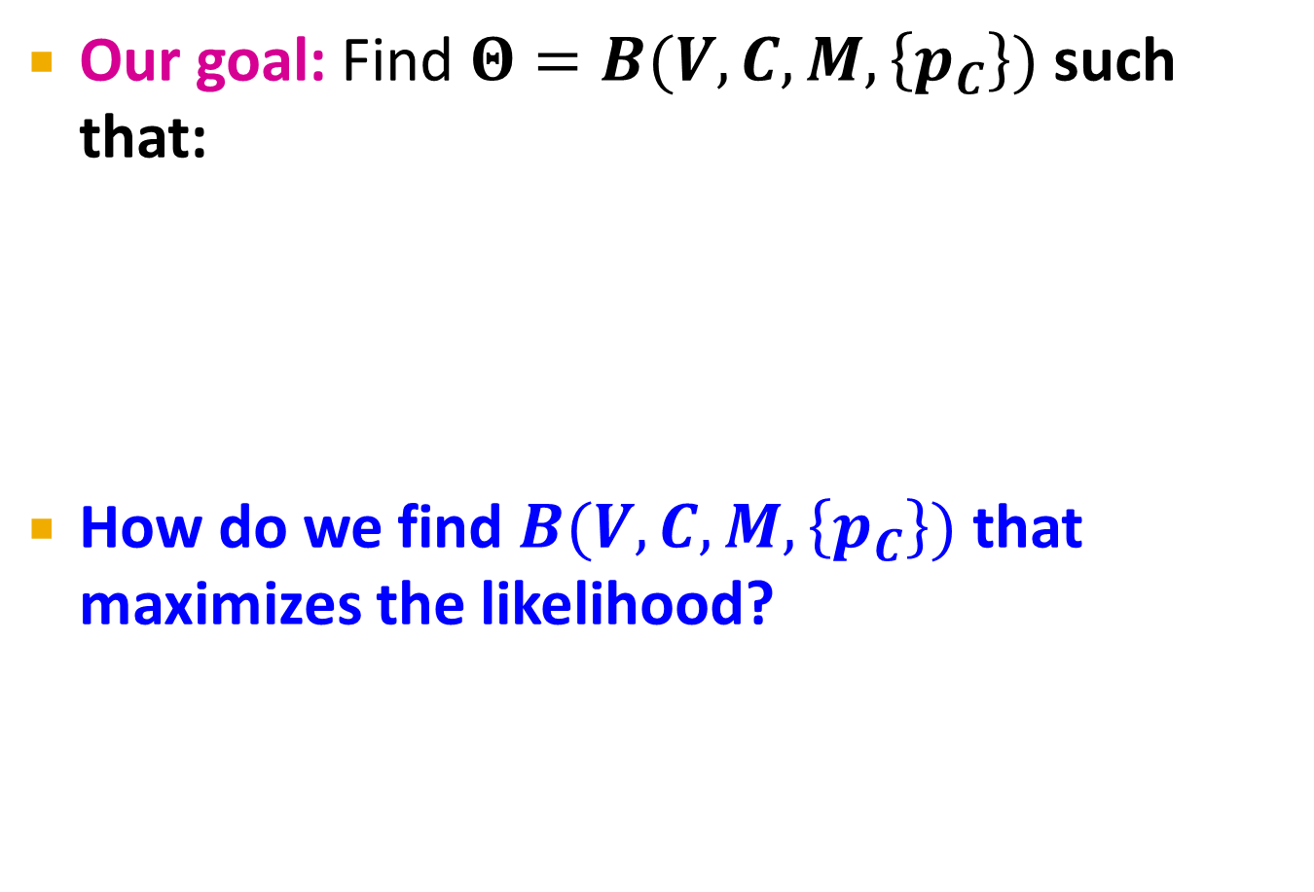

MLE for Graphs
Our goal: Find $Θ=B(V,C,M,\left\{p_{C}\right\})$ such that:
How do we find $B(V,C,M,\left\{p_{C}\right\})$ that maximizes the likelihood?
P(
|
)
$$G$$
AGM
arg max

Slide 25
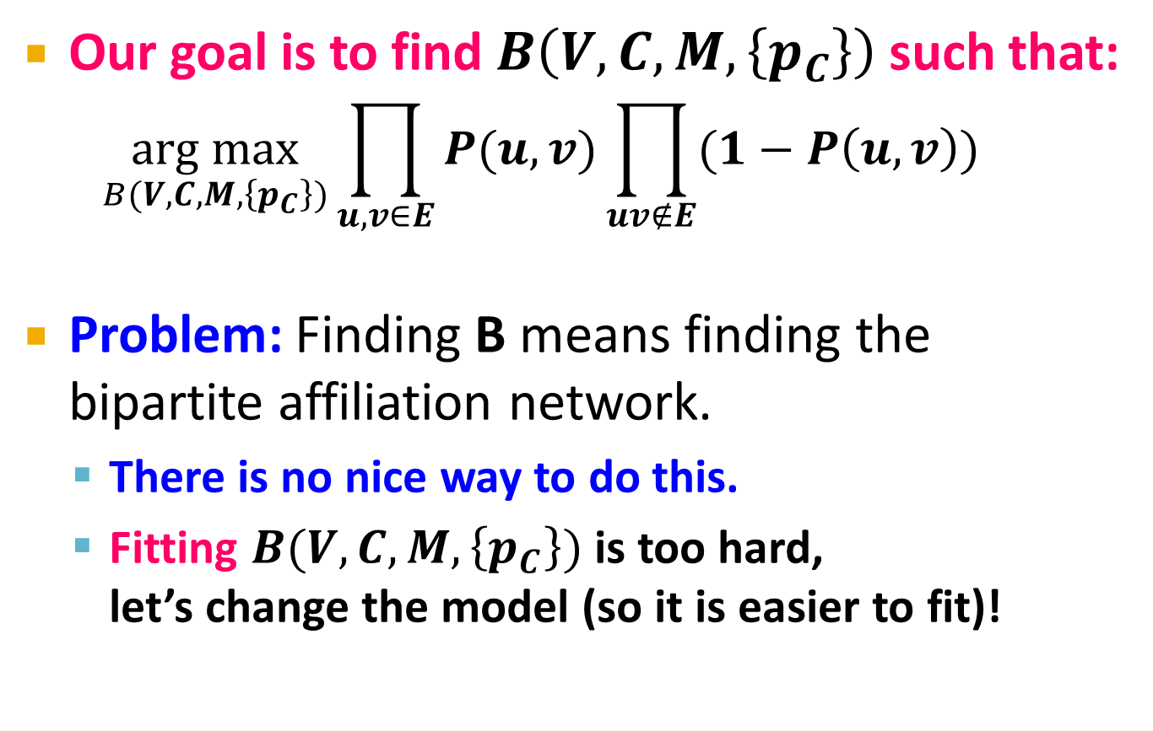
MLE for AGM
Our goal is to find $B\left(V,C,M,\left\{p_{C}\right\}\right)$ such that:
  $$\underset{B(V,C,M,\left\{p_{C}\right\})}{arg max}{\prod_{u,v∈E}{P(u,v){\prod_{uv∉E}{(1−P\left(u,v\right)})}^{}}}$$
Problem: Finding B means finding the bipartite affiliation network.
  There is no nice way to do this.
  Fitting $B(V,C,M,\left\{p_{C}\right\})$ is too hard,
  let’s change the model (so it is easier to fit)!

Slide 26
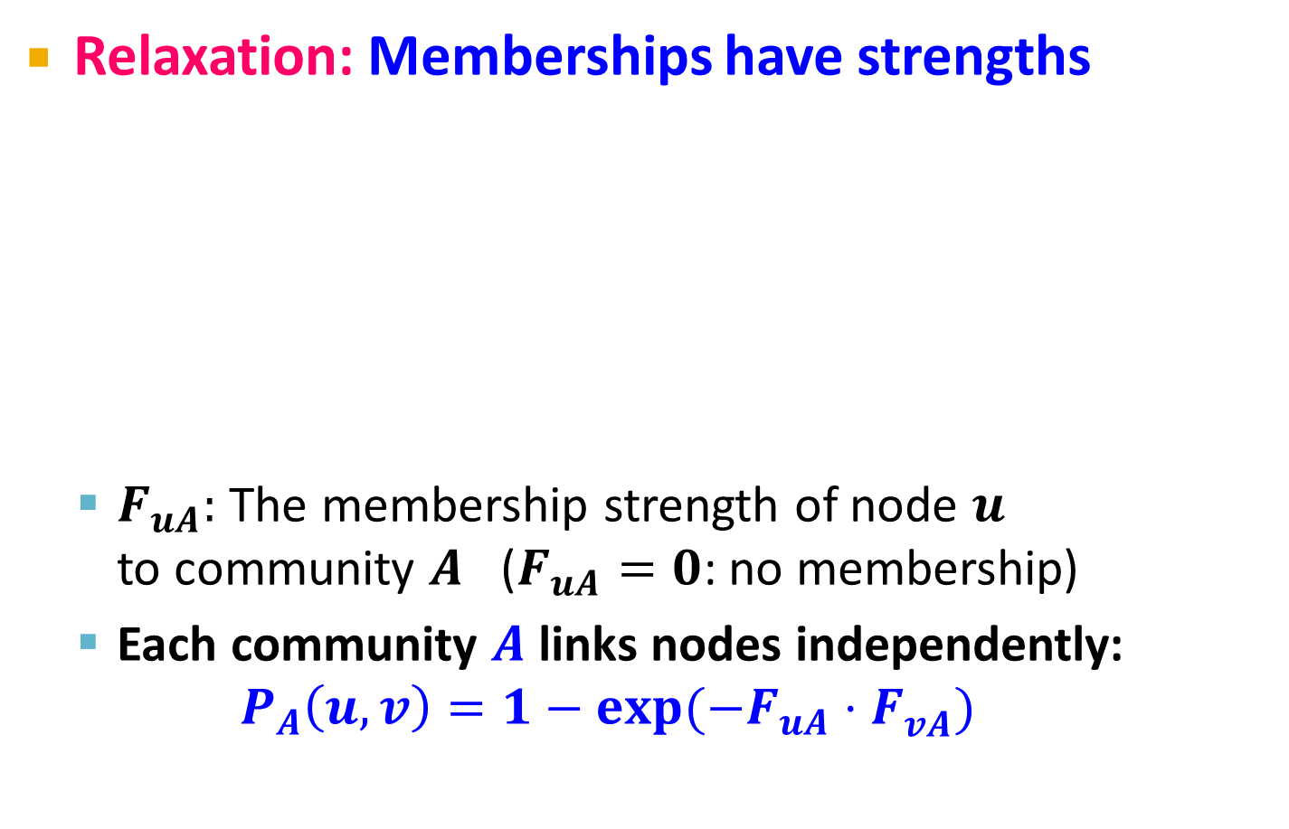

From AGM to BigCLAM
Relaxation: Memberships have strengths
  $F_{uA}:$ The membership strength of node $u$
  to community $A$ ($F_{uA}=0$: no membership)
  Each community $A$ links nodes independently:
  $$P_{A}\left(u,v\right)=1−exp⁡(−F_{uA}⋅F_{vA}^{})$$
$$F_{uA}$$
u
v

Slide 27

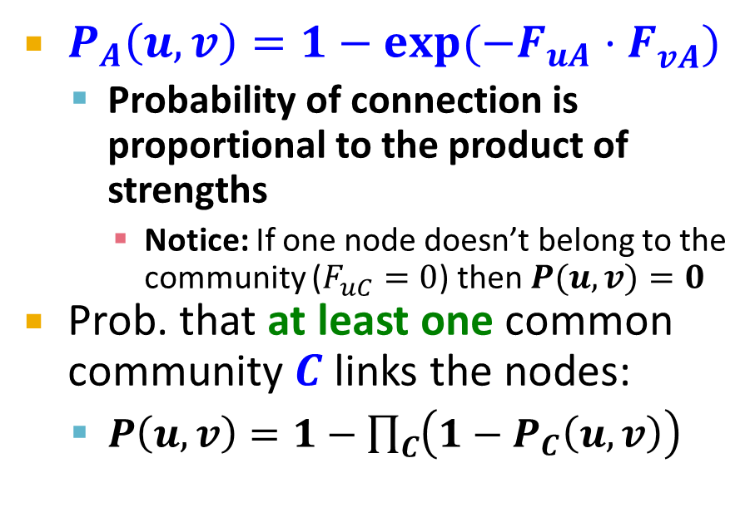
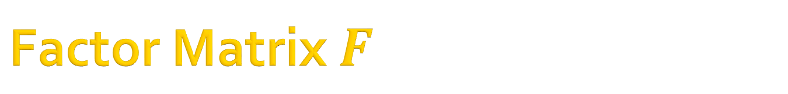
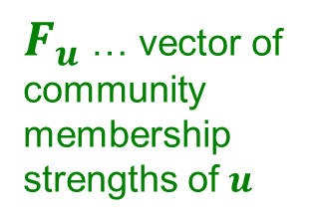
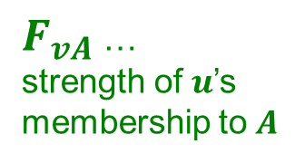
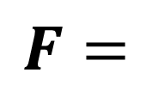
Factor Matrix $F$
Community membership strength matrix $F$
Communities
$P_{A}\left(u,v\right)=1−exp⁡(−F_{uA}⋅F_{vA}^{})$
  Probability of connection is
  proportional to the product of strengths
    Notice: If one node doesn’t belong to the community ($F_{uC}=0$) then $P(u,v)=0$
Prob. that at least one common community $C$ links the nodes:
  $P\left(u,v\right)=1−\prod_{C}{\left(1−P_{C}\left(u,v\right)\right)}$
Nodes
 | j
$$F=$$
$F_{u}$ … vector of
community
membership
strengths of $u$
$F_{vA}$ …
strength of $u$’s
membership to $A$

Slide 28

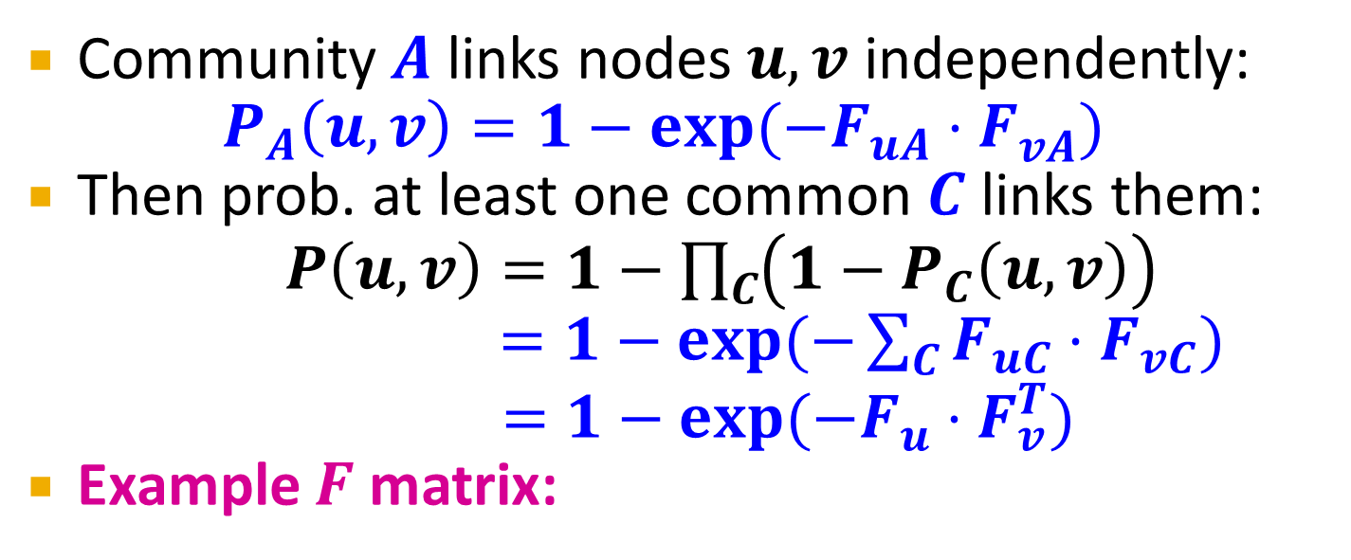

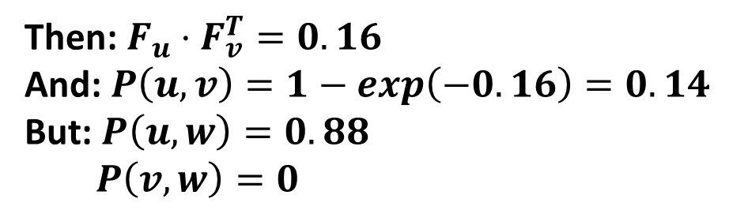

From AGM to BigCLAM
Community $A$ links nodes $u,v$ independently:
$P_{A}\left(u,v\right)=1−exp⁡(−F_{uA}⋅F_{vA}^{})$
Then prob. at least one common $C$ links them:
$P\left(u,v\right)=1−\prod_{C}{\left(1−P_{C}\left(u,v\right)\right)}$
$=1−exp⁡(−\sum_{C}{F_{uC}⋅F_{vC}})$
$$=1−exp⁡(−F_{u}⋅F_{v}^{T})$$
Example $F$ matrix:
$$F_{u}^{}:$$
0 | 1.2 | 0 | 0.2
Then: $F_{u}⋅F_{v}^{T}=0.16$
And: $P\left(u,v\right)=1−exp\left(−0.16\right)=0.14$
But: $P\left(u,w\right)=0.88$
$P\left(v,w\right)=0$
$$F_{v}^{}:$$
0.5 | 0 | 0 | 0.8
$$F_{w}^{}:$$
0 | 1.8 | 1 | 0
Node community
membership strengths

Slide 29
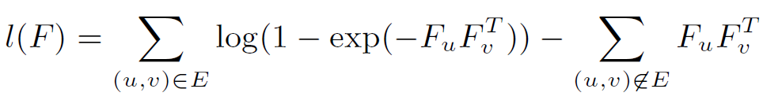

BigCLAM: How to find F
Task: Given a network $G(V,E)$, estimate $F$
  Find $F$ that maximizes the likelihood:
  $$arg max_{F} \prod_{(u,v)∈E}{P(u,v})\prod_{\left(u,v\right)∉E}{(1−P\left(u,v\right))}$$
    where: $P(u,v)=1−exp⁡(−F_{u}⋅F_{v}^{T})$
    Many times we take the logarithm of the likelihood,
    and call it log-likelihood: $l\left(F\right)=log⁡P(G|F)$
Goal: Find $F$ that maximizes $l(F)$:

Slide 30

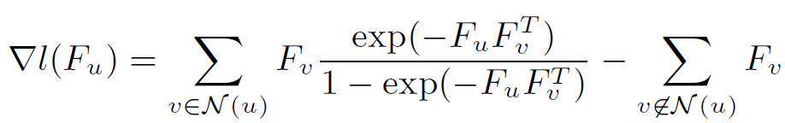
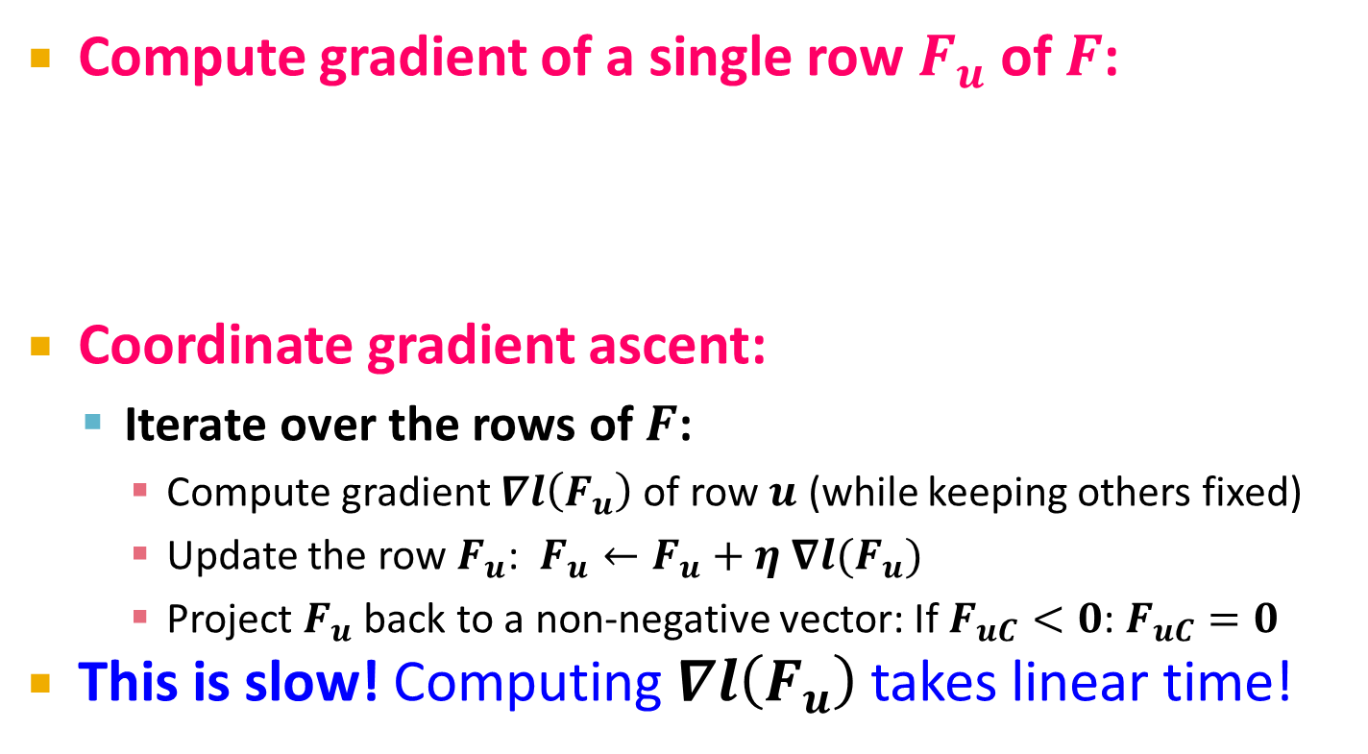
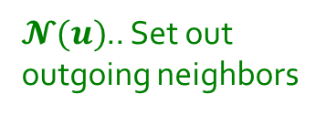
BigCLAM: V1.0
Compute gradient of a single row $F_{u}$ of $F$:
Coordinate gradient ascent:
  Iterate over the rows of $F$:
    Compute gradient $∇l\left(F_{u}\right)$ of row $u$ (while keeping others fixed)
    Update the row $F_{u}$: $F_{u}←F_{u}+η ∇l(F_{u})$
    Project $F_{u}$ back to a non-negative vector: If $F_{uC}<0$: $F_{uC}=0$
This is slow! Computing $∇l\left(F_{u}\right)$ takes linear time!
$𝓝(u)$.. Set out
outgoing neighbors

Slide 31
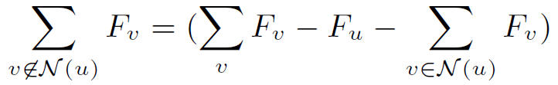
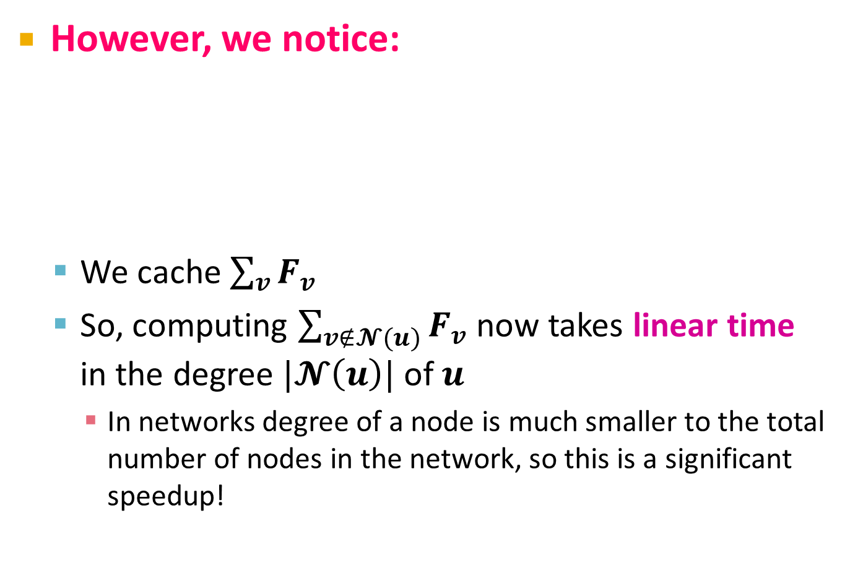
BigCLAM: V2.0
However, we notice:
  We cache $\sum_{v}{F_{v}}$
  So, computing $\sum_{v∉𝓝(u)}{F_{v}}$ now takes linear time
  in the degree $|𝓝\left(u\right)|$ of $u$
    In networks degree of a node is much smaller to the total number of nodes in the network, so this is a significant speedup!

Slide 32
BigClam: Scalability
BigCLAM takes 5 minutes for 300k node nets
  Other methods take 10 days
Can process networks with 100M edges!

Slide 33
Extension:
Directed memberships

Slide 34
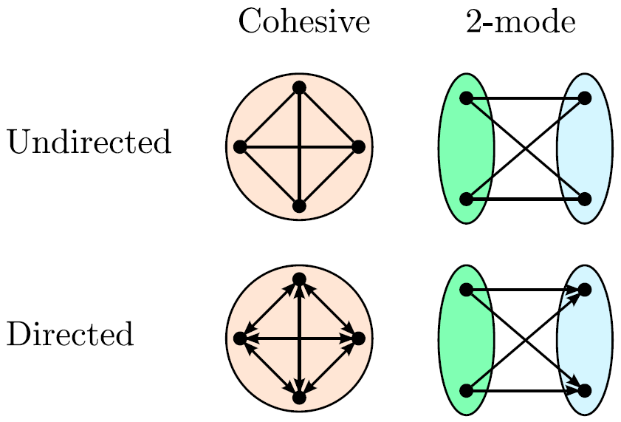
Extension: Beyond Clusters

Slide 35
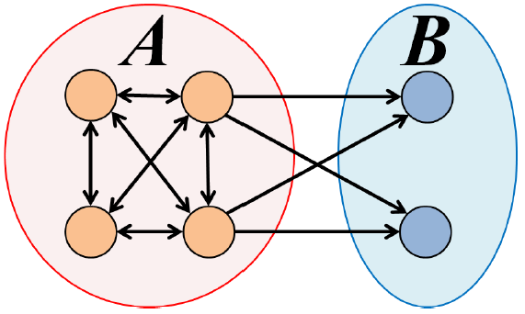
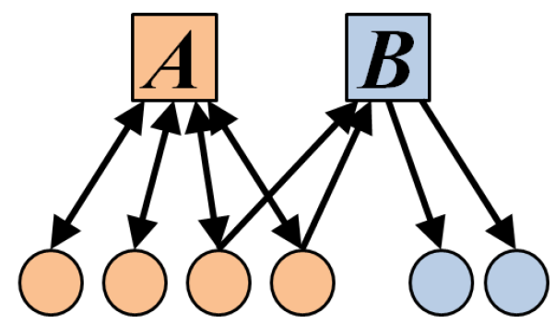
Extension: Directed AGM
Extension:
Make community membership edges directed!
  Outgoing membership: Nodes “sends” edges
  Incoming membership: Node “receives” edges

Slide 36
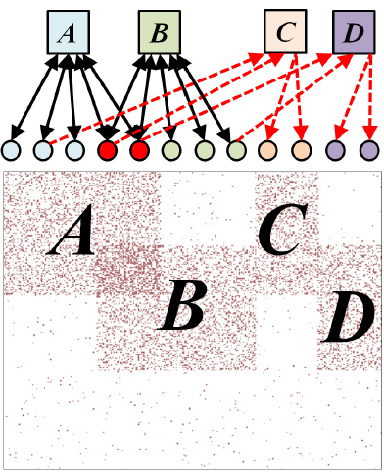
Example: Model and Network

Slide 37


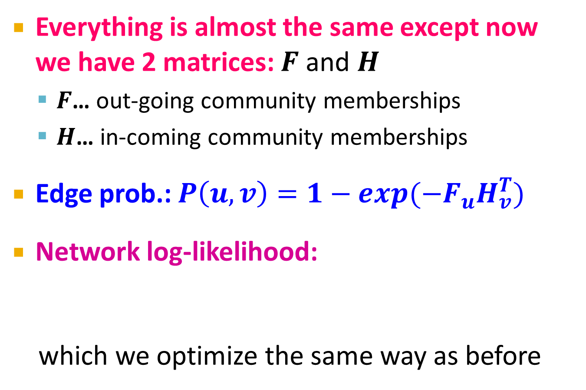


Directed AGM
Everything is almost the same except now we have 2 matrices: $F$ and $H$
  $F$… out-going community memberships
  $H$… in-coming community memberships
Edge prob.: $P\left(u,v\right)=1−exp(−F_{u}H_{v}^{T})$
Network log-likelihood:
which we optimize the same way as before
$$F$$
$$H$$

Slide 38
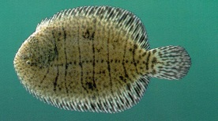
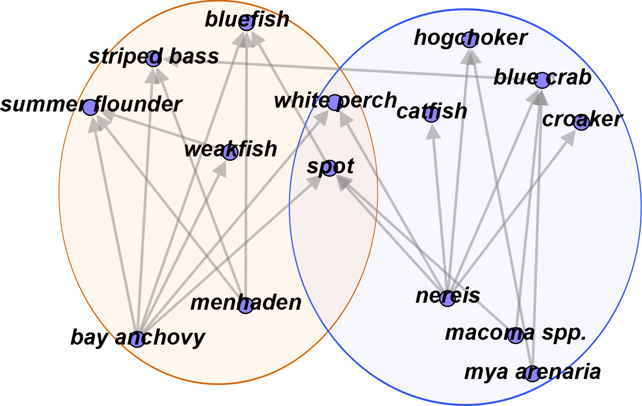
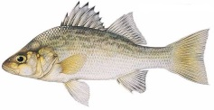




Predator-prey Communities

Slide 39
More details at…
Overlapping Community Detection at Scale: A Nonnegative Matrix Factorization Approach by J. Yang, J. Leskovec. ACM International Conference on Web Search and Data Mining (WSDM), 2013.
Detecting Cohesive and 2-mode Communities in Directed and Undirected Networks by J. Yang, J. McAuley, J. Leskovec. ACM International Conference on Web Search and Data Mining (WSDM), 2014.
Community Detection in Networks with Node Attributes by J. Yang, J. McAuley, J. Leskovec. IEEE International Conference On Data Mining (ICDM), 2013.

